Slide 1

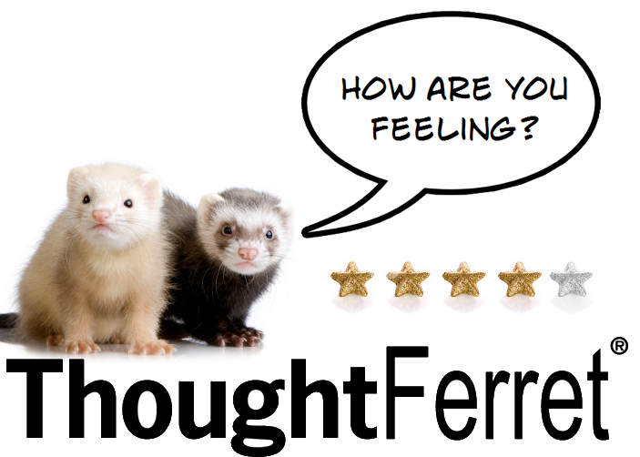
Romain Prieto
Fabio
Pereira

Slide 2
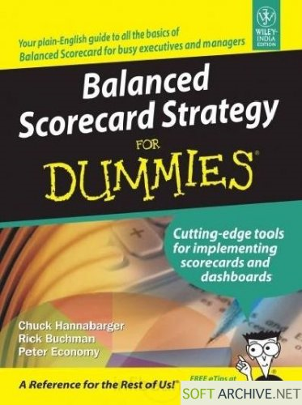
Notes:
This year the success of ThoughtWorks will be measured using a 'Balanced Scorecard'. This means that the Australian business will now be held accountable for not only financial measures, but also Social Engagement, Revenue/NOI-NetOperatingIncome and People.
Focus on our Mission, Values, by continuously, effectively and efficiently measuring our Strategic and Operation goals
Problem Statement
Over the past few years, ThoughtWorks has made major steps forward in our ability to measure business performance via operational metrics. Senior managers regularly review statistics such as utilization, revenue forecasts and income statements and use those metrics as inputs into their decision-making process to efficiently manage the business. Many of these metrics are also used to set targets for regional performance and some people have financial incentives based on meeting those operational targets (specifically NOI). As a result of this new ability to monitor our business operations, there is a perception that we have become overly focused on these financial metrics and that we have begun to define ‘success’ too narrowly too unilaterally as commercial/operational performance. Often leadership communications about the ‘state of the business’ focus overly on financial metrics at the expense of the ‘squishier’ elements such as adherence to our values, innovation, making a positive impact on our world and the progress we are making in our mission to revolutionize the IT industry. The primary purpose is beyond operational success – it is necessary but not sufficient. Therefore measuring only operational performance is inadequate. •Now that we have established a stable and sophisticated ability to monitor our operational health, we have an opportunity to build a much broader set of metrics to define our success and manage our business and that may act as leading indicators for financial success. These new metrics will help us ensure that we as a company are focusing on the right things and, while focusing on operational indicators in the short term is required, we need to set strategic indicators to define the long term viability and success of ThoughtWorks

Slide 3
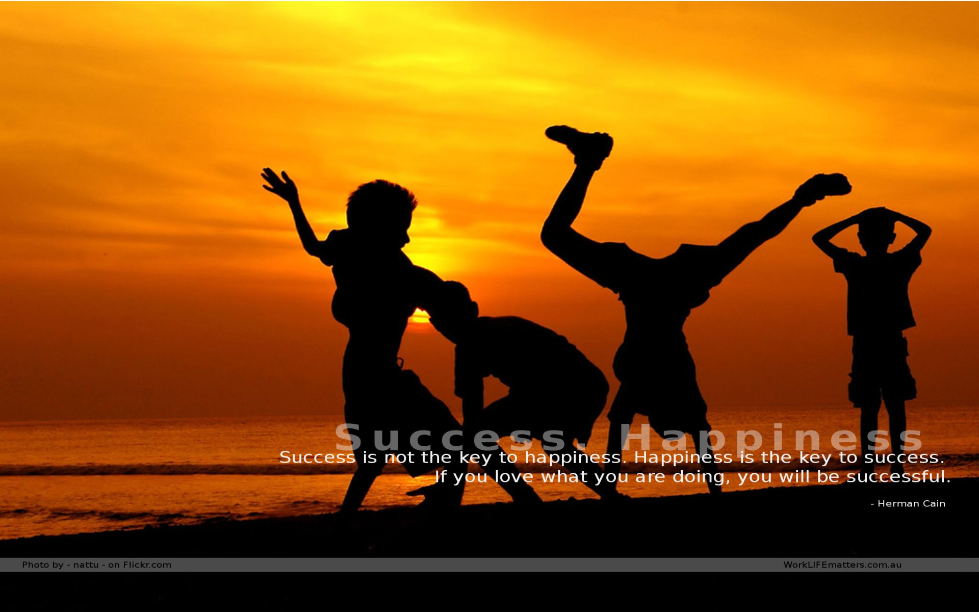

Slide 4
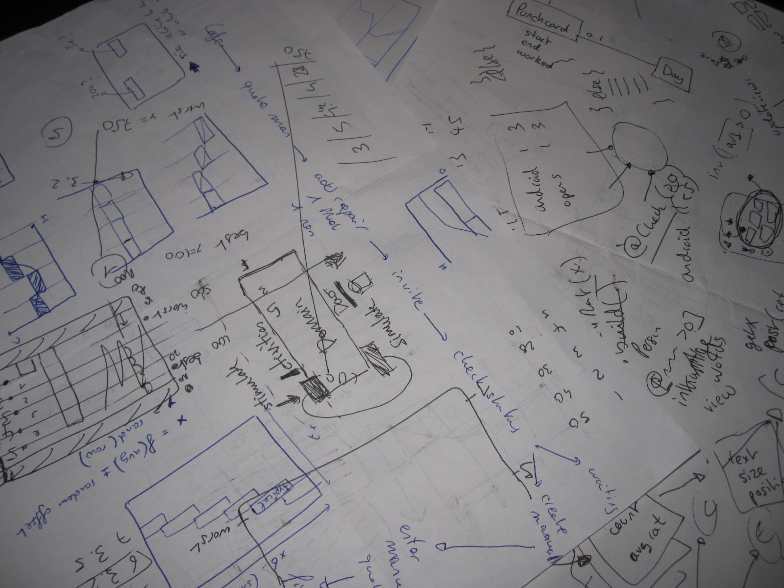
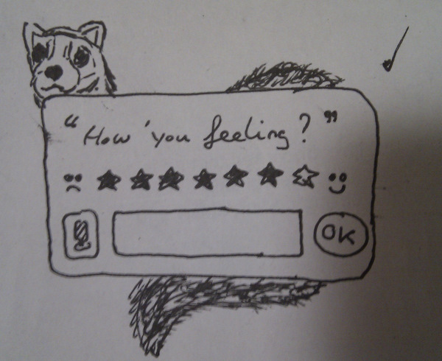
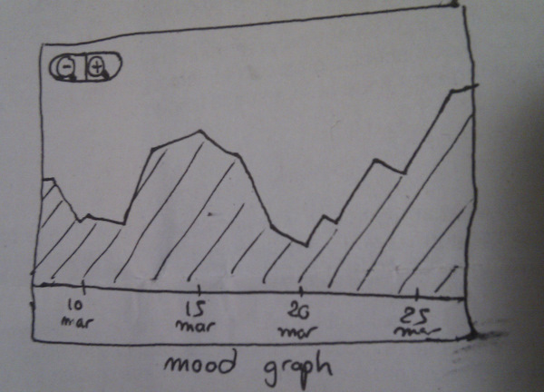
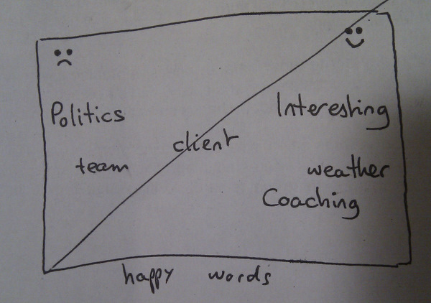

Slide 5
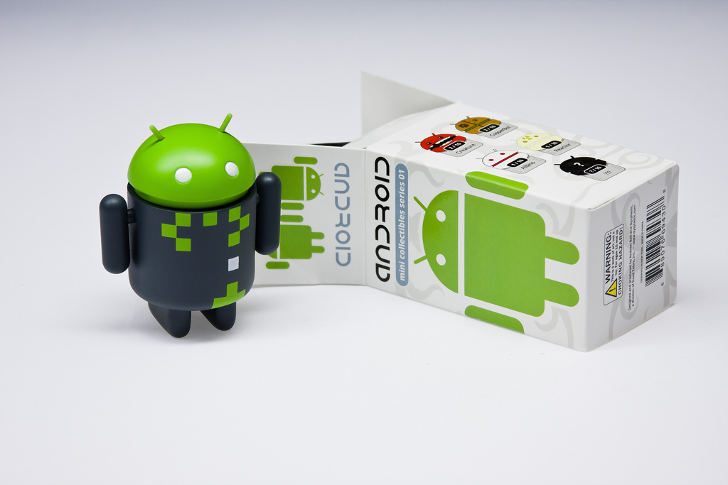
Notes:
List of new things we tried:
o Home
o Control animations
o Theming
· Update
o Keyboard? voice recognition
o Databases (SQLLite)
· Graph
o Custom rendering
o Option menu, basic controls
o Finger gestures
· Cloud
o Visualisation techniques
· Map
o Geolocation / GPS
o Custom map markers
· Preferences
o Application preferences
· Agent
o Alarm scheduling
o Notifications

Slide 6
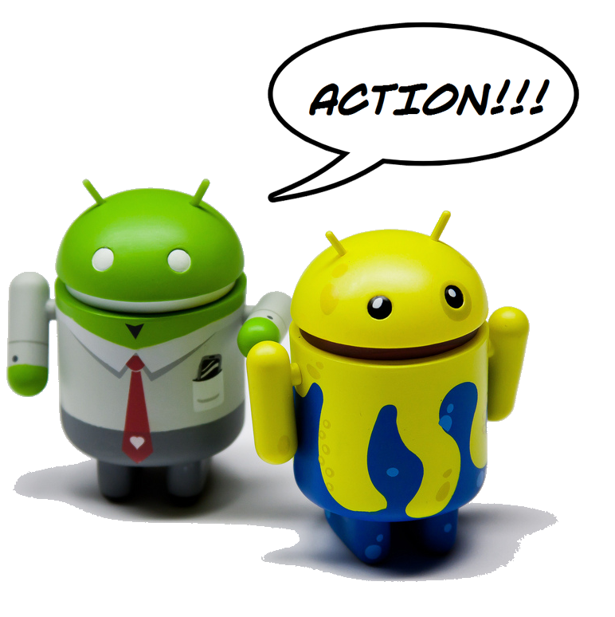




Slide 7
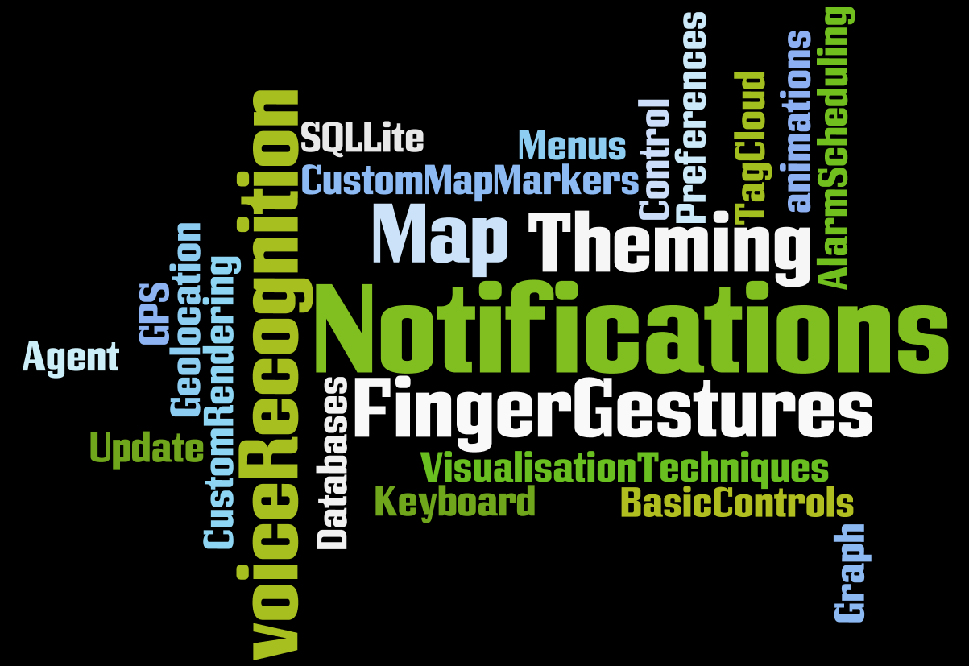

Slide 8
Activities, UI, Rendering
Domain
MoodRating
Reminder
JUnit
Timeline
TagCloud
Offices
DAO, Alarm

Slide 9


Slide 10
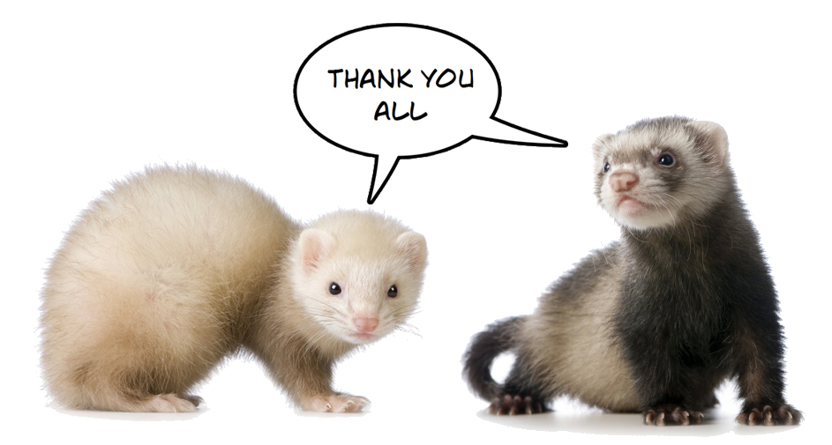
Fabio Pereira
Romain Prieto

